Slide 1


Electric Circuits
Twelfth Edition, Global Edition
Chapter 6 – Part 1
Inductance, Capacitance, and Mutual Inductance
© 2024 Pearson Education Ltd. All Rights Reserved.
Notes:
If this PowerPoint presentation contains mathematical equations, you may need to check that your computer has the following installed:
1) Math Type Plugin
2) Math Player (free versions available)
3) NVDA Reader (free versions available)

Slide 2
Chapter 6 – Inductance and Capacitance
Objectives:
6.1 Inductor
  6.1.1 Equations for v, i, p, and w
  6.1.2 Behavior in the presence of constant current
  6.1.3 Continuity requirements
  6.1.4 Combine in series and in parallel
6.2 Capacitor
  6.2.1 Equations for v, i, p, and w
  6.2.2 Behavior in the presence of constant voltage
  6.2.3 Continuity requirements
  6.2.4 Combine in series and in parallel

Slide 3
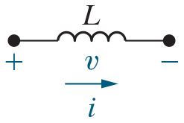
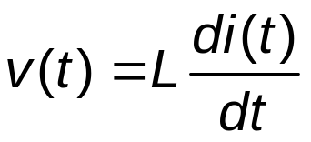
Chapter 6 – Inductors (1 of 17)
Coil of wire with time-varying current
  time-varying magnetic field
  time-varying voltage drop
Inductor equation:
Units: v(t) is volts, i(t) is amps, and L is henries [H]

Slide 4

Chapter 6 – Inductors (2 of 17)
Look at the inductor equation again:
Suppose i(t) is constant. Then v(t) =
A. L
B. 0
C. Undefined

Slide 5


Chapter 6 – Inductors (2 of 17)
Look at the inductor equation again:
Suppose i(t) is constant. Then v(t) =
A. L
B. 0
C. Undefined

Slide 6
Chapter 6 – Inductors (3 of 17)
So, if the current in an inductor is constant, its voltage drop is 0, so the inductor can be replaced by
A. A short circuit
B. An open circuit
C. A capacitor

Slide 7
Chapter 6 – Inductors (3 of 17)
So, if the current in an inductor is constant, its voltage drop is 0, so the inductor can be replaced by
A. A short circuit
B. An open circuit
C. A capacitor

Slide 8
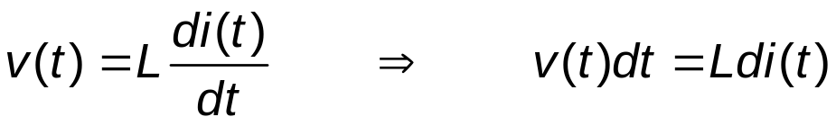
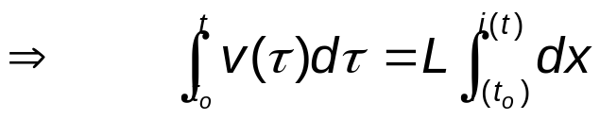
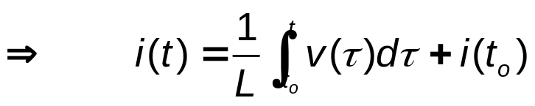
Chapter 6 – Inductors (6 of 17)
The equation for current in terms of voltage:

Slide 9
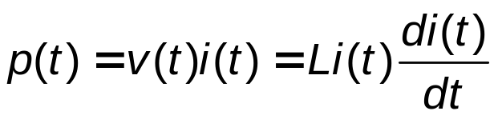
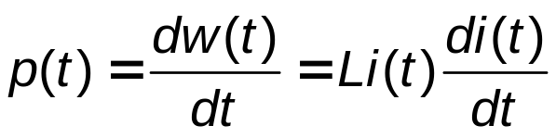

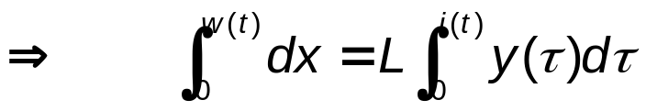

Chapter 6 – Inductors (7 of 17)
Power and energy

Slide 10
Chapter 6 – Inductors (8 of 17)
Inductors are energy storage devices!
  If the initial current through the inductor is non-zero, the inductor is storing energy.

Slide 11
Chapter 6 – Inductors (9 of 17)
Suppose the initial current through a 2 m H inductor is 1 A. The initial energy stored in the inductor is
A. 1 m J
B. 2 m J
C. 4 m J

Slide 12
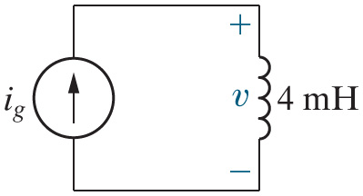



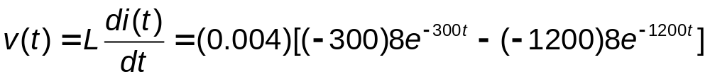
Chapter 6 – Inductors (10 of 17)
Example
Notes:
Long Description:
equals Open Parenthesis 0.004 Close Parenthesis Open SquareBracket Open Parenthesis negative 300 Close Parenthesis 8 e to the negative 300 t power minus Open Parenthesis negative 1200 Close Parenthesis 8 e to the negative 1200 t power Close SquareBracket.

Slide 13

Chapter 6 – Inductors (11 of 17)
Example (continued)
Find the power for the inductor:
To find the max power and the time at which the power is max, take the first derivative of p(t) and set it equal to 0.

Slide 14


Chapter 6 – Inductors (12 of 17)
Example (continued)
Find the energy for the inductor:
To find the max energy and the time at which the energy is max, take the first derivative of w(t) and set it equal to 0. Or if you don’t have w(t) yet, do the same for i(t)!

Slide 15
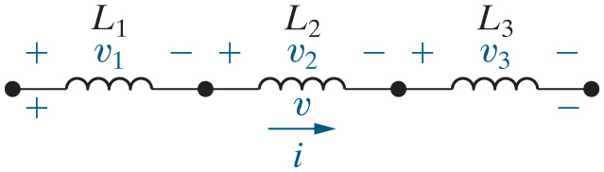
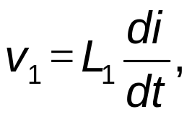
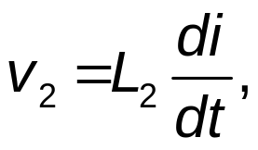
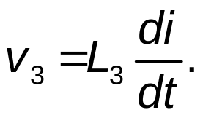
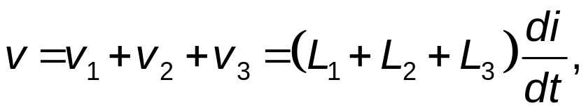
Chapter 6 – Inductors (13 of 17)
Inductors connected in series:
and
K V L:
Inductors in series ADD.

Slide 16
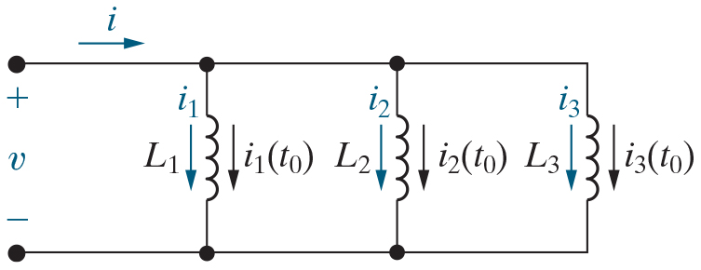

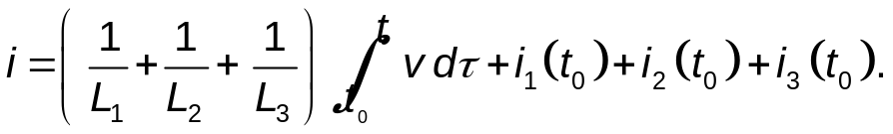
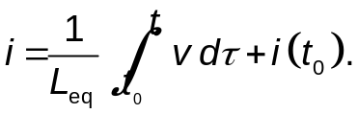
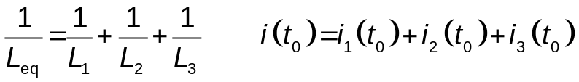
Chapter 6 – Inductors (14 of 17)
Inductors connected in parallel:
K C L:
Inductors combine in parallel like resistors combine in parallel.
Notes:
Long Description 1:
i subscript 1 Base Line equals Start Fraction 1 over L subscript 1 End Fraction Integral from t subscript 0 Base Line to t of v d Tau plus i subscript 1 Base Line Open Parenthesis t subscript 0 Close Parenthesis, i subscript 2 Base Line equals Start Fraction 1 over L subscript 2 End Fraction Integral from t subscript 0 Base Line to t of v d Tau plus i subscript 2 Base Line Open Parenthesis t subscript 0 Close Parenthesis, i subscript 3 Base Line equals Start Fraction 1 over L subscript 3 End Fraction Integral from t subscript 0 Base Line to t of v d Tau plus i subscript 3 Base Line Open Parenthesis t subscript 0 Close Parenthesis.
Long Description 2:
i equals Open Parenthesis Start Fraction 1 over L subscript 1 End Fraction plus Start Fraction 1 over L subscript 2 End Fraction plus Start Fraction 1 over L subscript 3 End Fraction Close Parenthesis Integral from t subscript 0 Base Line to t of v d Tau plus i subscript 1 Base Line Open Parenthesis t subscript 0 Close Parenthesis plus i subscript 2 Base Line Open Parenthesis t subscript 0 Close Parenthesis plus i subscript 3 Base Line Open Parenthesis t subscript 0 Close Parenthesis.
Long Description 3:
Start Fraction 1 over L subscript eq End Fraction equals Start Fraction 1 over L subscript 1 End Fraction plus Start Fraction 1 over L subscript 2 End Fraction plus Start Fraction 1 over L subscript 3 End Fraction
i Open Parenthesis t subscript 0 Close Parenthesis equals i subscript 1 Base Line Open Parenthesis t subscript 0 Close Parenthesis plus i subscript 2 Base Line Open Parenthesis t subscript 0 Close Parenthesis plus i subscript 3 Base Line Open Parenthesis t subscript 0 Close Parenthesis.

Slide 17


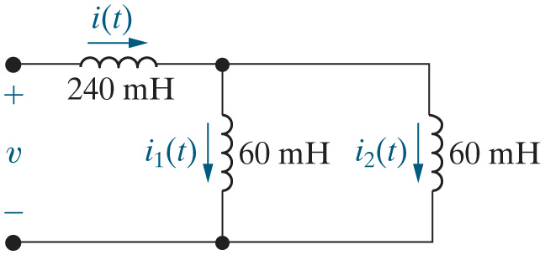





Chapter 6 – Inductors (15 of 17)
Find the equivalent inductance for the circuit below, assuming
and
A.
B.
C.

Slide 18
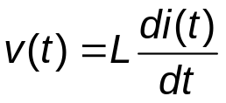
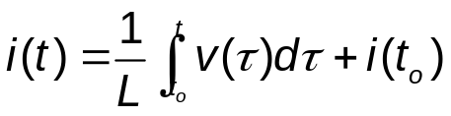


Chapter 6 – Inductors (16 of 17)
Inductor summary
Equation Type | Equation
Symbol | An image shows an inductor with an inductance of L henrys, and two terminals marked with positive and negative polarities. Its voltage is marked as v, while current i flows rightward in the direction of voltage drop.
Units | Henries [H]
Describing equation | v Open Parenthesis t Close Parenthesis equals L Start Fraction d i Open Parenthesis t Close Parenthesis over d t End Fraction.
Other equation | i Open Parenthesis t Close Parenthesis equals Start Fraction 1 over L End Fraction Integral from t subscript o Base Line to t of v Open Parenthesis Tau Close Parenthesis d Tau plus i Open Parenthesis t subscript o Close Parenthesis.
Initial condition | i Open Parenthesis t subscript o Close Parenthesis.
Behavior with const. source | If i Open Parenthesis t Close Parenthesis equals I, v Open Parenthesis t Close Parenthesis equals 0 tends to. short circuit
Continuity requirement | i(t) is continuous so v(t) is finite

Slide 19
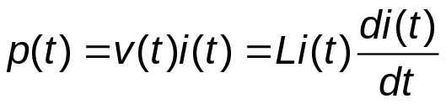



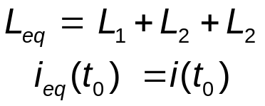
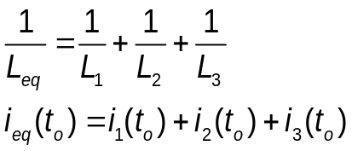
Chapter 6 – Inductors (17 of 17)
Inductor summary
Equation Type | Equation
Power | p Open Parenthesis t Close Parenthesis equals v Open Parenthesis t Close Parenthesis i Open Parenthesis t Close Parenthesis equals L i Open Parenthesis t Close Parenthesis Start Fraction d i Open Parenthesis t Close Parenthesis over d t End Fraction.
Energy | w Open Parenthesis t Close Parenthesis equals Start Fraction 1 over 2 End Fraction L i Open Parenthesis t Close Parenthesis squared.
Initial energy | w subscript o Base Line Open Parenthesis t Close Parenthesis equals Start Fraction 1 over 2 End Fraction L i Open Parenthesis t subscript o Close Parenthesis squared.
Trapped energy | w Open Parenthesis infinity Close Parenthesis equals Start Fraction 1 over 2 End Fraction L i Open Parenthesis infinity Close Parenthesis squared.
Series-connected | L subscript e q Base Line equals L subscript 1 Base Line plus L subscript 2 Base Line plus L subscript 2. i subscript e q Base Line Open Parenthesis t subscript 0 Close Parenthesis equals i Open Parenthesis t subscript 0 Close Parenthesis.
Parallel-connected | Start Fraction 1 over L subscript e q End Fraction equals Start Fraction 1 over L subscript 1 End Fraction plus Start Fraction 1 over L subscript 2 End Fraction plus Start Fraction 1 over L subscript 3 End Fraction. i subscript e q Base Line Open Parenthesis t subscript o Close Parenthesis equals i subscript 1 Base Line Open Parenthesis t subscript o Close Parenthesis plus i subscript 2 Base Line Open Parenthesis t subscript o Close Parenthesis plus i subscript 3 Base Line Open Parenthesis t subscript o Close Parenthesis.

Slide 20

Copyright
This work is protected by United Kingdom copyright laws and is provided solely for the use of instructors in teaching their courses and assessing student learning. Dissemination or sale of any part of this work (including on the World Wide Web) will destroy the integrity of the work and is not permitted. The work and materials from it should never be made available to students except by instructors using the accompanying text in their classes. All recipients of this work are expected to abide by these restrictions and to honor the intended pedagogical purposes and the needs of other instructors who rely on these materials.

